Slide 1
Randomized Algorithms CS648
Lecture 16
Random sampling (last lecture)
Randomized Incremental Construction - I

Slide 2
Recap of the previous lecture

Slide 3
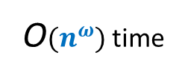
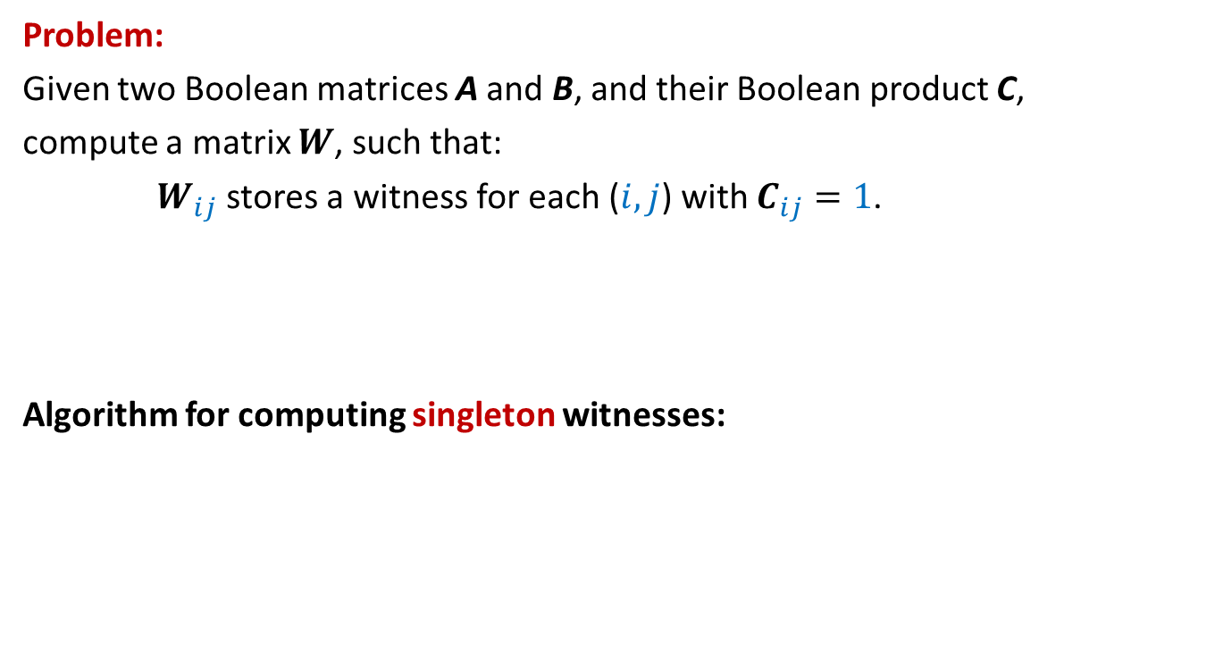
Boolean Product Witness Matrix (BPWM)
Problem:
Given two Boolean matrices A and B, and their Boolean product C,
compute a matrix $W$, such that:
$W_{ij}$ stores a witness for each ($i,j$) with $C_{ij}=1$.
Algorithm for computing singleton witnesses:
O$(n^{ω})$ time

Slide 4
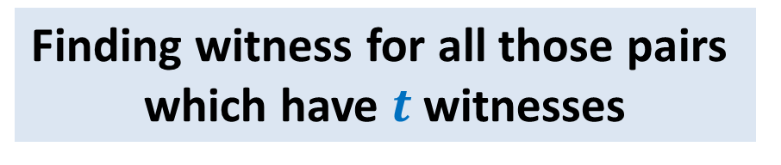

Randomized O$(n^{ω} log n)$ Algorithm:
Finding witness for all those pairs
which have $t$witnesses

Slide 5



Focus on a single pair ($i$,$j$)
$$j$$
1 | 0 | 1 | 1 | 1 | 0 | 0 | 1 | 0 | 1
 |  |  |  |  |  |  | 1
 |  |  |  |  |  |  | 1
 |  |  |  |  |  |  | 0
 |  |  |  |  |  |  | 1
 |  |  |  |  |  |  | 1
 |  |  |  |  |  |  | 0
 |  |  |  |  |  |  | 1
 |  |  |  |  |  |  | 1
 |  |  |  |  |  |  | 0
 |  |  |  |  |  |  | 0
$$i$$
A
B

Slide 6



Focus on a single pair ($i$,$j$)
$$j$$
1 2 3 4 … n
⨯ ⨯ ⨯ ⨯ ⨯ ⨯ ⨯ ⨯ ⨯ ⨯
1 | 0 | 1 | 1 | 1 | 0 | 0 | 1 | 0 | 1
 |  |  |  |  |  |  | 1
 |  |  |  |  |  |  | 1
 |  |  |  |  |  |  | 0
 |  |  |  |  |  |  | 1
 |  |  |  |  |  |  | 1
 |  |  |  |  |  |  | 0
 |  |  |  |  |  |  | 1
 |  |  |  |  |  |  | 1
 |  |  |  |  |  |  | 0
 |  |  |  |  |  |  | 0
$$i$$
A
B
How to nullify the effect of $t−1$witnesses ?
Witnesses for ($i$,$j$)

Slide 7
Focus on a single pair ($i$,$j$)
$$j$$
1 2 3 4 … n
⨯ ⨯ ⨯ ⨯ ⨯ ⨯ ⨯ ⨯ ⨯ ⨯
1 | 0 | 1 | 1 | 1 | 0 | 0 | 1 | 0 | 1
 |  |  |  |  |  |  | 1
 |  |  |  |  |  |  | 1
 |  |  |  |  |  |  | 0
 |  |  |  |  |  |  | 1
 |  |  |  |  |  |  | 1
 |  |  |  |  |  |  | 0
 |  |  |  |  |  |  | 1
 |  |  |  |  |  |  | 1
 |  |  |  |  |  |  | 0
 |  |  |  |  |  |  | 0
$$i$$
A
B

Slide 8
Focus on a single pair ($i$,$j$)
$$j$$
1 2 3 4 5 … n-1 n
⨯ ⨯ ⨯ ⨯ ⨯ ⨯ ⨯ ⨯ ⨯ ⨯
1 | 0 | 1 | 1 | 1 | 0 | 0 | 1 | 0 | 1
 |  |  |  |  |  |  | 1
 |  |  |  |  |  |  | 1
 |  |  |  |  |  |  | 0
 |  |  |  |  |  |  | 1
 |  |  |  |  |  |  | 1
 |  |  |  |  |  |  | 0
 |  |  |  |  |  |  | 1
 |  |  |  |  |  |  | 1
 |  |  |  |  |  |  | 0
 |  |  |  |  |  |  | 0
$$i$$
A
B

Slide 9

Focus on a single pair ($i$,$j$)
$$j$$
0 2 3 0 5 … n-1 0
⨯ ⨯ ⨯ ⨯ ⨯ ⨯ ⨯ ⨯ ⨯ ⨯
1 | 0 | 1 | 1 | 1 | 0 | 0 | 1 | 0 | 1
 |  |  |  |  |  |  | 1
 |  |  |  |  |  |  | 1
 |  |  |  |  |  |  | 0
 |  |  |  |  |  |  | 1
 |  |  |  |  |  |  | 1
 |  |  |  |  |  |  | 0
 |  |  |  |  |  |  | 1
 |  |  |  |  |  |  | 1
 |  |  |  |  |  |  | 0
 |  |  |  |  |  |  | 0
$$i$$
A
B
$D_{ij}$ will store this witness for ($i$,$j$) now ☺.

Slide 10


Randomized algorithm for Computing Witnesses for all pairs with $t$witnesses
//The pseudo code for sampling the (indices of) columns
Sample($n$, $p$)
{ $R$← $∅$;
For each $k∈[n]$ do:
add $k$to $R$ with probability $p$;
return $R$;
}

Slide 11
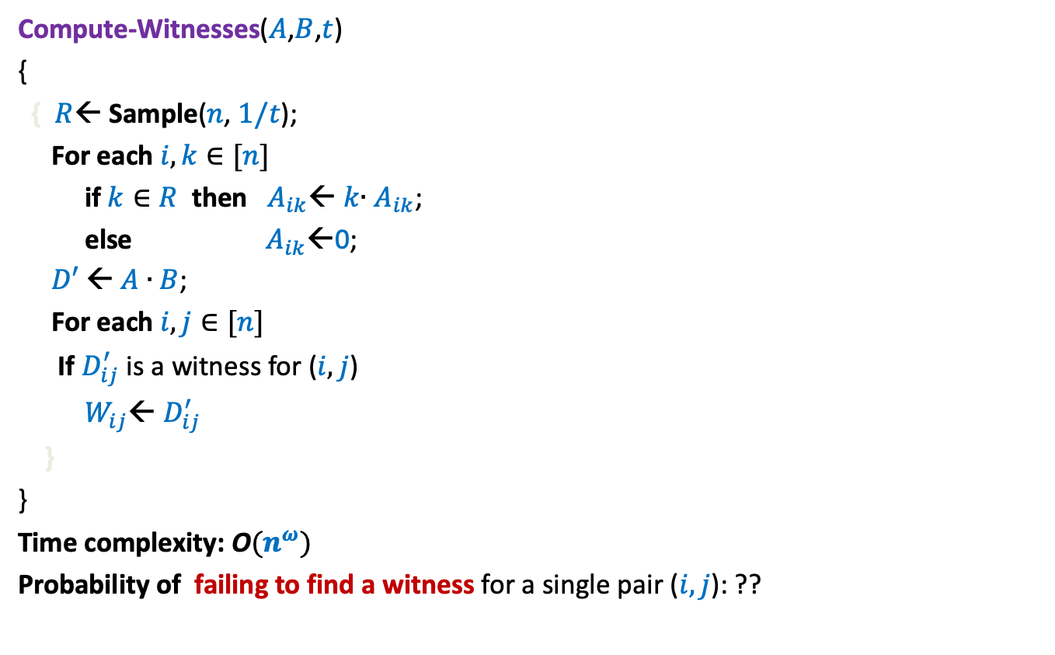
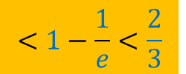
Randomized algorithm for Computing Witnesses for all pairs with $t$witnesses
Compute-Witnesses($A$,$B$,$t$)
{
{ $R$← Sample($n$, $1/t$);
For each $i,k∈[n]$
if $k∈R$ then $A_{ik}$← $k$∙ $A_{ik}$;
else $A_{ik}$←0;
$D′$← $A$ ∙ $B$;
For each $i,j∈[n]$
If $D_{ij}^{′}$ is a witness for ($i,j$)
$W_{ij}$← $D_{ij}^{′}$
}
}
Time complexity: O$(n^{ω})$
Probability of failing to find a witness for a single pair ($i,j$): ??
Boost success probability by repetition
$$<1−\frac{1}{e}<\frac{2}{3}$$

Slide 12
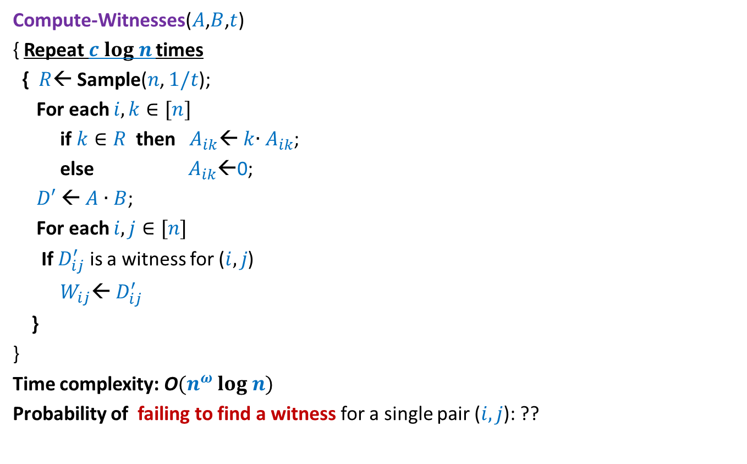
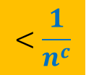
Randomized algorithm for Computing Witnesses for all pairs with $t$witnesses
Compute-Witnesses($A$,$B$,$t$)
{ Repeat $c log n$times
{ $R$← Sample($n$, $1/t$);
For each $i,k∈[n]$
if $k∈R$ then $A_{ik}$← $k$∙ $A_{ik}$;
else $A_{ik}$←0;
$D′$← $A$ ∙ $B$;
For each $i,j∈[n]$
If $D_{ij}^{′}$ is a witness for ($i,j$)
$W_{ij}$← $D_{ij}^{′}$
}
}
Time complexity: O$(n^{ω} log n)$
Probability of failing to find a witness for a single pair ($i,j$): ??
$$<\frac{1}{n^{c}}$$

Slide 13
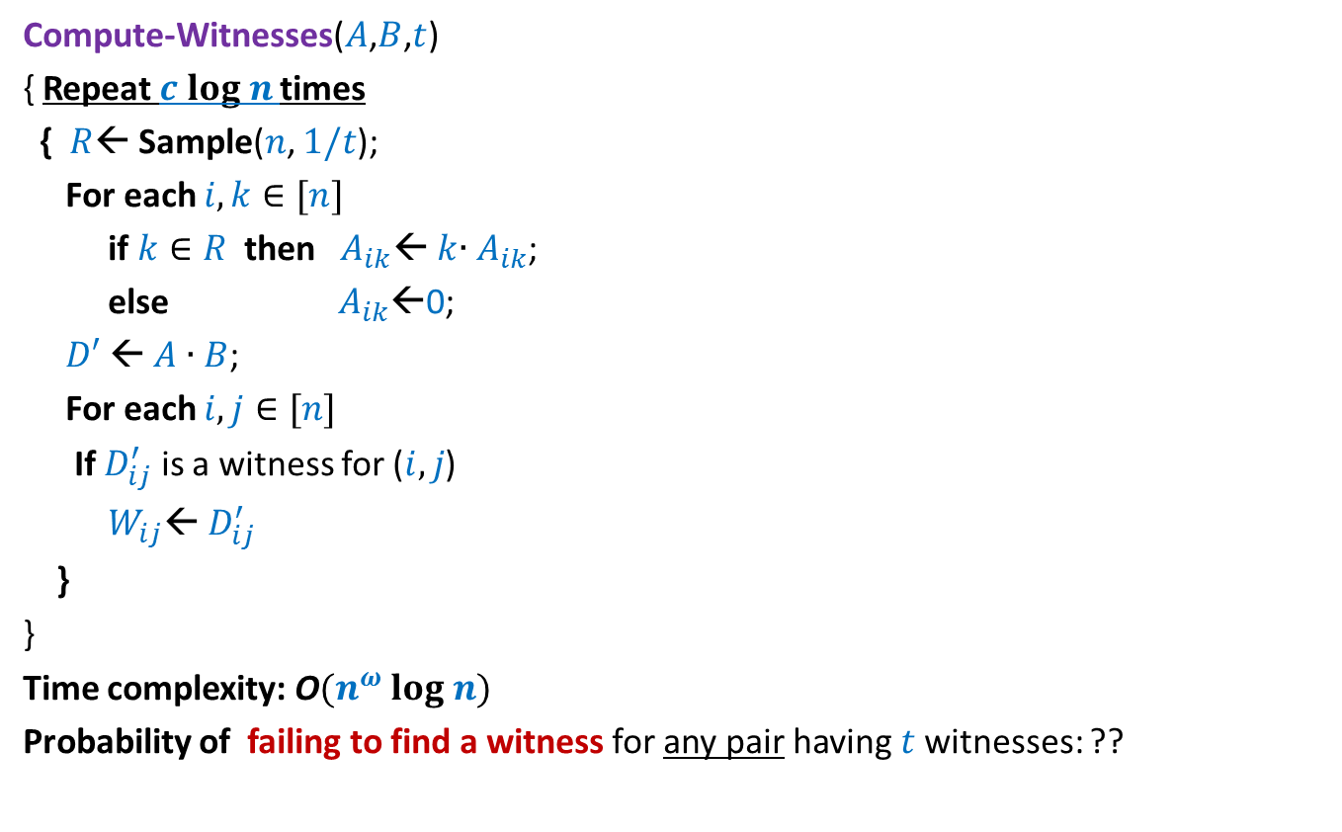

Randomized algorithm for Computing Witnesses for all pairs with $t$witnesses
Compute-Witnesses($A$,$B$,$t$)
{ Repeat $c log n$times
{ $R$← Sample($n$, $1/t$);
For each $i,k∈[n]$
if $k∈R$ then $A_{ik}$← $k$∙ $A_{ik}$;
else $A_{ik}$←0;
$D′$← $A$ ∙ $B$;
For each $i,j∈[n]$
If $D_{ij}^{′}$ is a witness for ($i,j$)
$W_{ij}$← $D_{ij}^{′}$
}
}
Time complexity: O$(n^{ω} log n)$
Probability of failing to find a witness for any pair having $t$witnesses: ??
Union Theorem
$<\frac{m}{n^{c}}$ < $\frac{1}{n^{c−2}}$

Slide 14
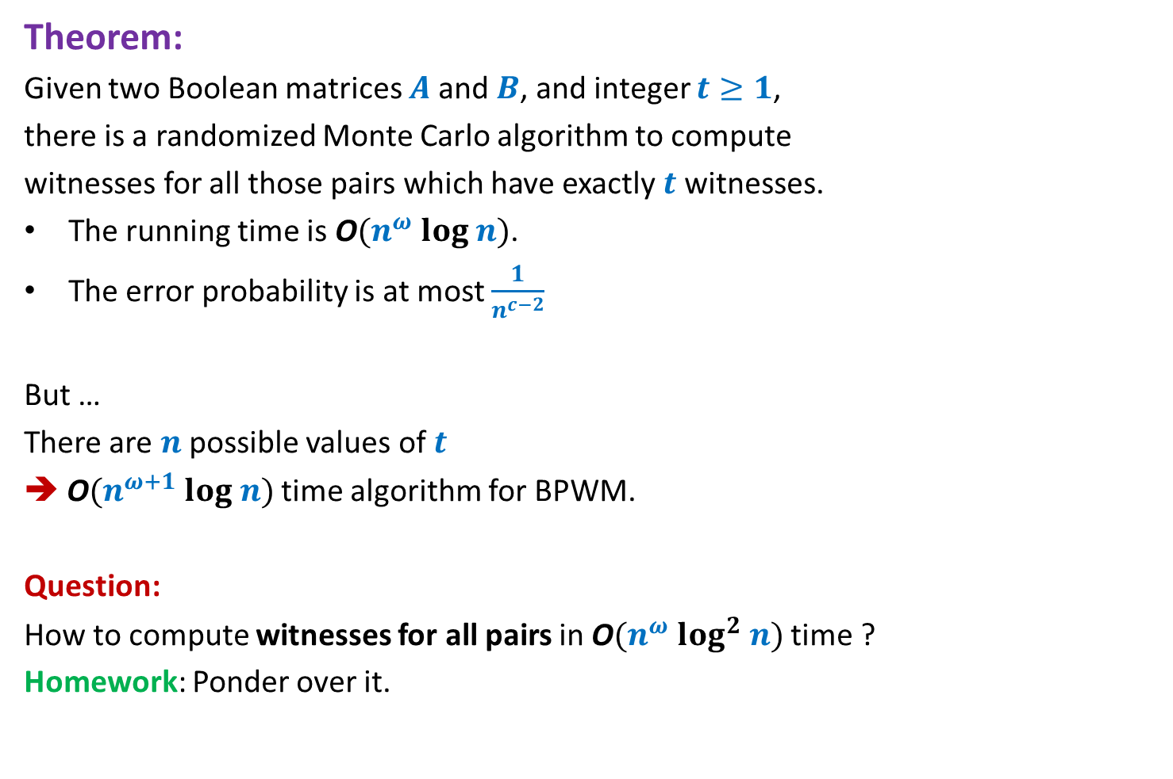
Algorithm for BPWM
Theorem:
Given two Boolean matrices $A$and $B$, and integer $t≥1$,
there is a randomized Monte Carlo algorithm to compute
witnesses for all those pairs which have exactly $t$ witnesses.
The running time is O$(n^{ω} log n)$.
The error probability is at most $\frac{1}{n^{c−2}}$
But …
There are $n$possible values of $t$
➔ O$(n^{ω+1} log n)$ time algorithm for BPWM.
Question:
How to compute witnesses for all pairs in O$(n^{ω} log^{2} n)$ time ?
Homework: Ponder over it.

Slide 15
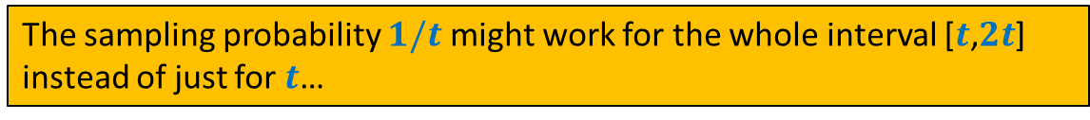






We seem to be too rigid in our approach
No. of witnesses | Sampling probability
$$t$$
$$1/t$$
$$t+1$$
$$1/(t+1)$$
…
…
$$2t$$
$$1/(2t)$$
The sampling probability $1/t$ might work for the whole interval [$t$,$2t$]
instead of just for $t$…

Slide 16

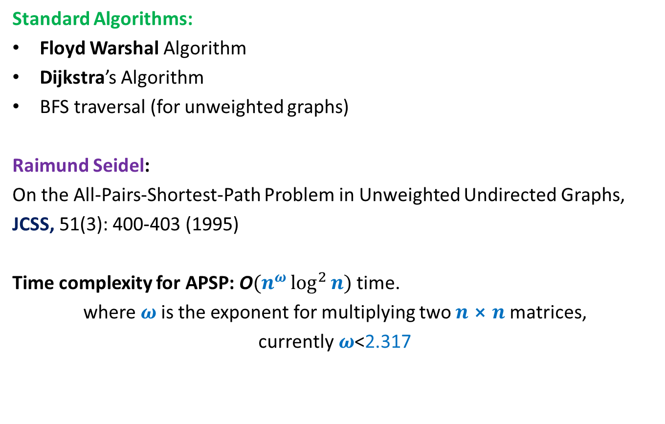
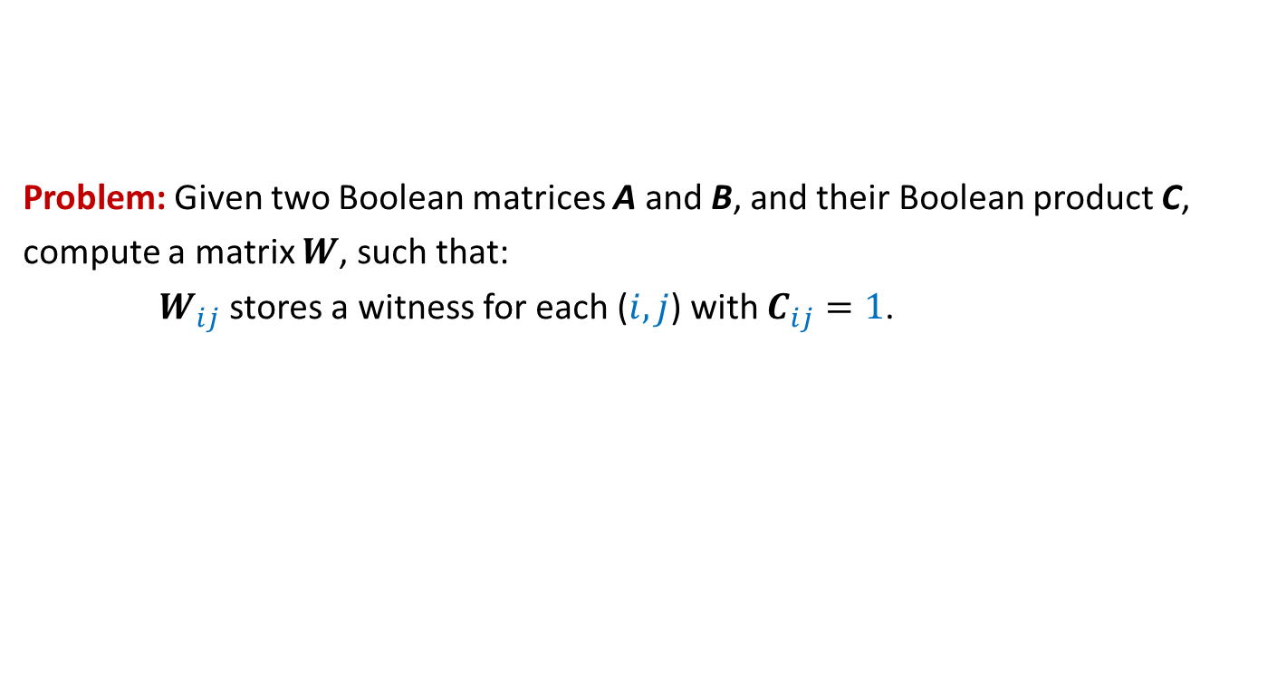
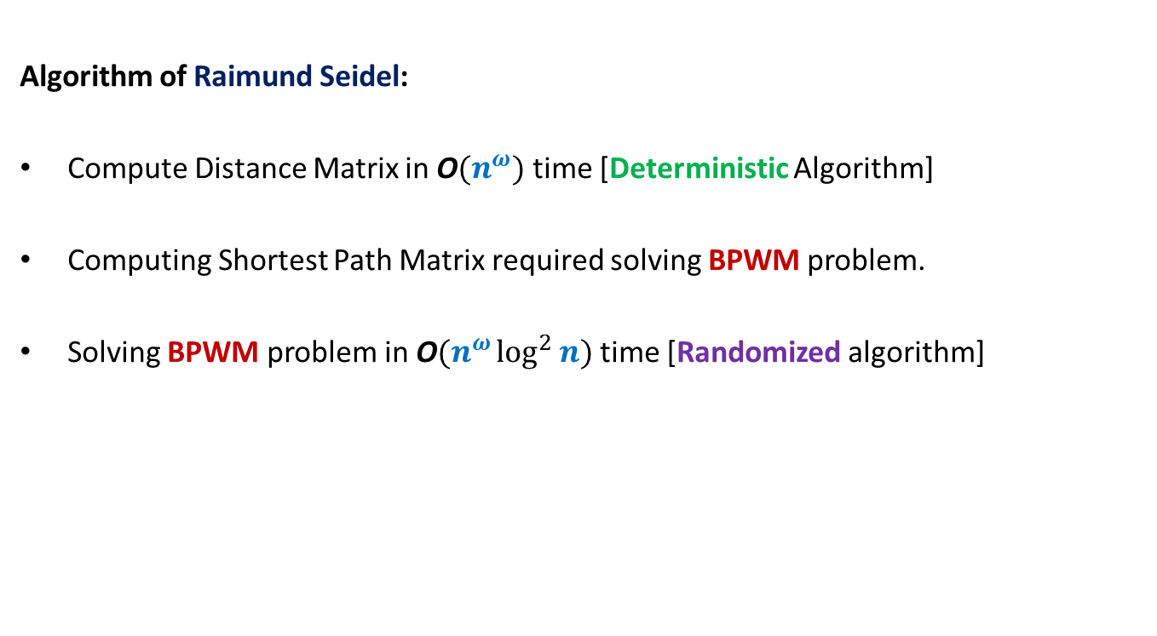
Focus on a single pair ($i$,$j$)
Let there be $w$ witnesses for ($i$,$j$)
Question: If each column is selected independently with $p=1/t$ ,
what is the probability that exactly one out of $w$witnesses for ($i$,$j$) survives ?
Answer:
=$\left({w \atop 1}\right)\frac{1}{t}{\left(1−\frac{1}{t}\right)}^{w−1}$
$≥ {\left(1−\frac{1}{t}\right)}^{w−1}$
$≥{\left(1−\frac{1}{t}\right)}^{2t −2}$
$≥\frac{1}{e^{2}}$
= $0.135…$
such that $t≤w<2t$
$$>\frac{1}{8}$$

Slide 17



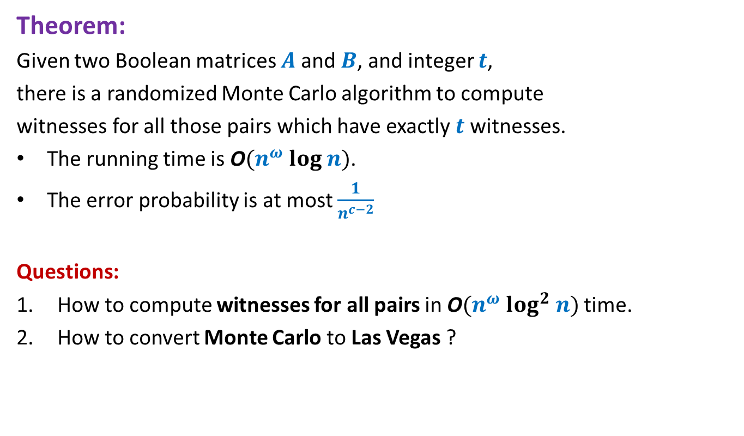

Randomized algorithm for Computing Witnesses for all pairs with witness count
$$∈[t,2t)$$
Compute-Witnesses($A$,$B$,$t$)
{
{ $R$← Sample($n$, $1/t$);
For each $i,k∈[n]$
if $k∈R$ then $A_{ik}$← $k$∙ $A_{ik}$;
else $A_{ik}$←0;
$D′$← $A$ ∙ $B$;
For each $i,j∈[n]$
If $D_{ij}^{′}$ is a witness for ($i,j$)
$W_{ij}$← $D_{ij}^{′}$
}
}
Time complexity: O$(n^{ω})$
Probability of failing to find a witness for a single pair ($i,j$): ??
How to reduce the error probability to $<\frac{1}{n^{c}}$ ?
Repeat the entire process ${c log}_{8/7} n$ times.
$$<1−\frac{1}{8}<\frac{7}{8}$$

Slide 18
Randomized algorithm for Computing Witnesses for all pairs with witness count
$$∈[t,2t)$$
Compute-Witnesses($A$,$B$,$t$)
{
{ $R$← Sample($n$, $1/t$);
For each $i,k∈[n]$
if $k∈R$ then $A_{ik}$← $k$∙ $A_{ik}$;
else $A_{ik}$←0;
$D′$← $A$ ∙ $B$;
For each $i,j∈[n]$
If $D_{ij}^{′}$ is a witness for ($i,j$)
$W_{ij}$← $D_{ij}^{′}$
}
}
Time complexity: O$(n^{ω})$
Probability of failing to find a witness for a single pair ($i,j$): ??
$$<1−\frac{1}{8}<\frac{7}{8}$$

Slide 19



Randomized algorithm for Computing Witnesses for all pairs with witness count
$$∈[t,2t)$$
Compute-Witnesses($A$,$B$,$t$)
{
{ $R$← Sample($n$, $1/t$);
For each $i,k∈[n]$
if $k∈R$ then $A_{ik}$← $k$∙ $A_{ik}$;
else $A_{ik}$←0;
$D′$← $A$ ∙ $B$;
For each $i,j∈[n]$
If $D_{ij}^{′}$ is a witness for ($i,j$)
$W_{ij}$← $D_{ij}^{′}$
}
}
Time complexity: O$(n^{ω})$
Probability of failing to find a witness for a single pair ($i,j$): ??
Repeat $c log_{8/7} n$times
{
}
$$\log{n})$$
$$<\frac{1}{n^{c}}$$

Slide 20
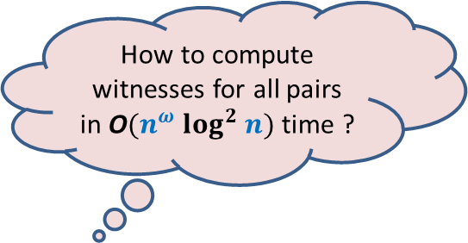
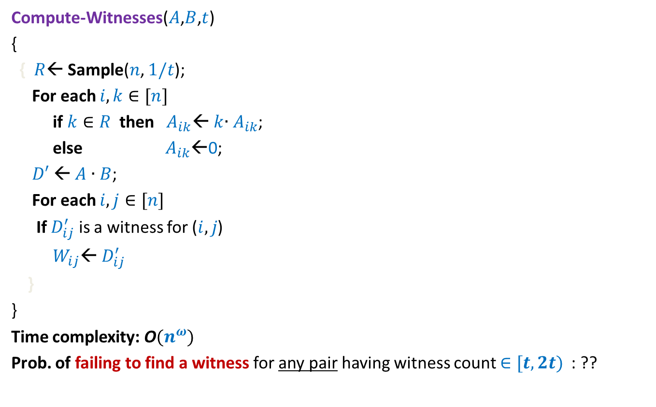

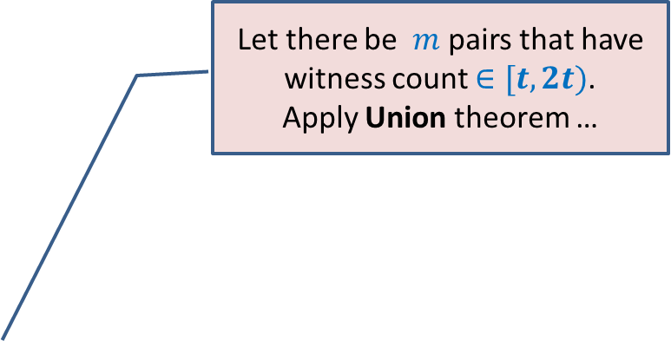
Randomized algorithm for Computing Witnesses for all pairs with witness count
$$∈[t,2t)$$
Compute-Witnesses($A$,$B$,$t$)
{
{ $R$← Sample($n$, $1/t$);
For each $i,k∈[n]$
if $k∈R$ then $A_{ik}$← $k$∙ $A_{ik}$;
else $A_{ik}$←0;
$D′$← $A$ ∙ $B$;
For each $i,j∈[n]$
If $D_{ij}^{′}$ is a witness for ($i,j$)
$W_{ij}$← $D_{ij}^{′}$
}
}
Time complexity: O$(n^{ω})$
Prob. of failing to find a witness for any pair having witness count $∈[t,2t)$ : ??
Repeat $c log_{8/7} n$times
How to compute witnesses for all pairs in O$(n^{ω} log^{2} n)$ time ?
{
Homework 1
Let there be $m$ pairs that have witness count $∈[t,2t)$.
Apply Union theorem …
}
$$\log{n})$$
$<\frac{m}{n^{c}}$ < $\frac{1}{n^{c−2}}$

Slide 21
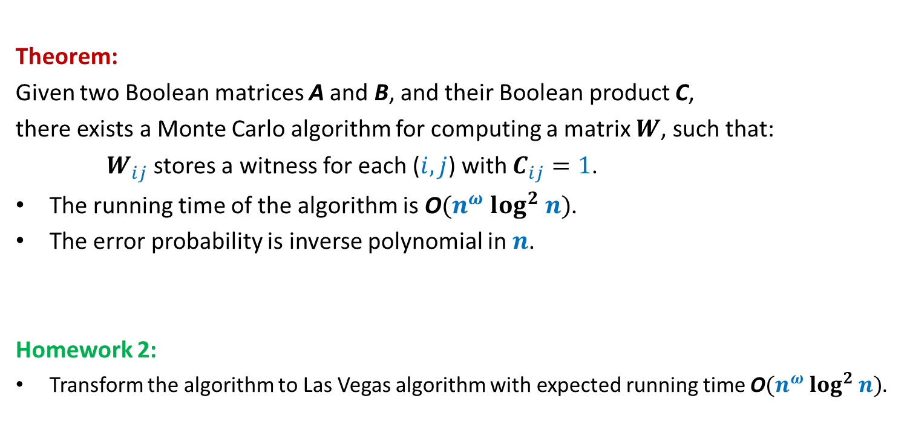
Boolean Product Witness Matrix (BPWM)
Theorem:
Given two Boolean matrices A and B, and their Boolean product C,
there exists a Monte Carlo algorithm for computing a matrix $W$, such that:
$W_{ij}$ stores a witness for each ($i,j$) with $C_{ij}=1$.
The running time of the algorithm is O$(n^{ω} log^{2} n)$.
The error probability is inverse polynomial in $n$.
Homework 2:
Transform the algorithm to Las Vegas algorithm with expected running time O$(n^{ω} log^{2} n)$.

Slide 22
Randomized Incremental Construction

Slide 23
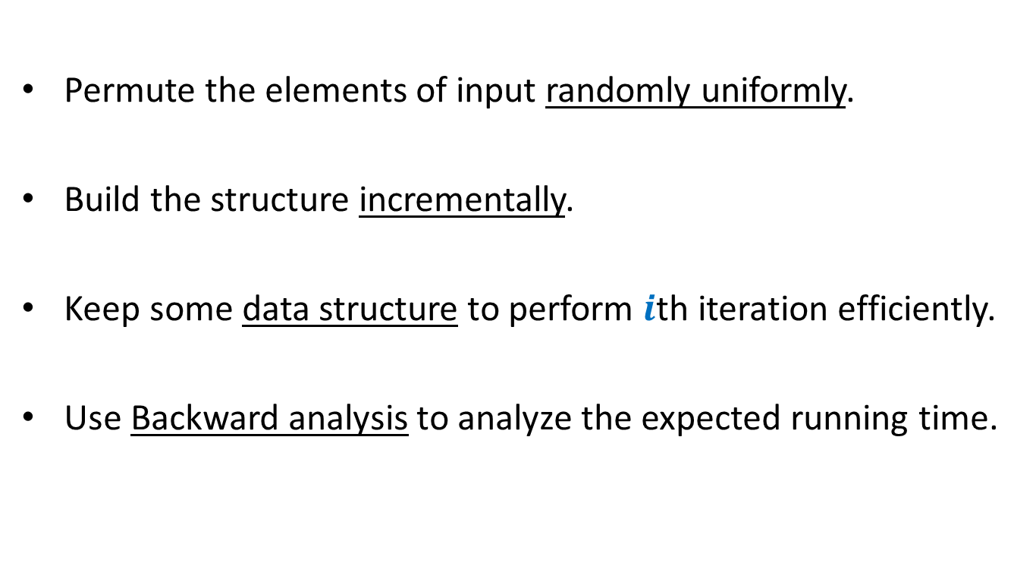
Randomized Incremental Construction
Permute the elements of input randomly uniformly.
Build the structure incrementally.
Keep some data structure to perform $i$th iteration efficiently.
Use Backward analysis to analyze the expected running time.
It is just a careful application of the Partition theorem discussed in the past.

Slide 24
Partition Theorem
A set of events $A_{1}$,…, $A_{n}$defined over a probability space ($Ω$,P) such
$\bigcup_{i=1}^{n}{A_{i}}$ = $Ω$
$A_{i}\bigcap{A_{j}}$ =∅ for all$i≠j$
Partition Theorem:
B
Ω
This theorem solves many difficult problems magically. However, for this you need to come up with the right partition.
P(B) = $\sum_{i}{\text{P}\text{(}{\text{B}\text{∩}A}_{i}}$ )
$\sum_{i}{\text{P}\text{(}\text{B} | A_{i}}$) ∙ $\text{P}\text{(}A_{i}$)

Slide 25
Partition Theorem
A set of events $A_{1}$,…, $A_{n}$defined over a probability space ($Ω$,P) such
$\bigcup_{i=1}^{n}{A_{i}}$ = $Ω$
$A_{i}\bigcap{A_{j}}$ =∅ for all$i≠j$
Partition Theorem:
Which partition is useful ?
B
Ω
Same for each $A_{i}$
P(B) = $\sum_{i}{\text{P}\text{(}{\text{B}\text{∩}A}_{i}}$ )
$\sum_{i}{\text{P}\text{(}\text{B} | A_{i}}$) ∙ $\text{P}\text{(}A_{i}$)

Slide 26
A motivational gem
There are $n$ points in plane.
We select a random sample of $n/2$ points.

Slide 27
A motivational gem
There are $n$ points in plane.
We select a random sample of $n/2$ points.
Let C be the smallest enclosing circle of sampled points.
What is the worst case no. of unsampled points lying outside C ?
What is the expected no. of unsampled points lying outside C ?
C
$$n/2$$
< $10$

Slide 28
problem 1 Closest Pair of Points

Slide 29
Closest Pair of Points
Problem Definition:
Given a set $P$of $n>1$points in plane,
compute the pair of points with minimum Euclidean distance.
Deterministic algorithms:
O($n^{2}$) : Trivial algorithm
O($n log n$) : Divide and Conquer based algorithm
Randomized algorithm:
O($n$) : Randomized Incremental Construction based algorithm

Slide 30
Notations and assumptions
Notations:
$P$ : set of $n$points in plane.
Coordinates of each point are positive integers.
distance($p$,$q$) : Euclidean distance between $p$and $q$.
Assumption:
Distance between each pair of points is distinct.

Slide 31
A discrete math exercise
Exercise:
What is the maximum number of points that can be placed in a unit square
such that the minimum distance is at least 1 ?
Answer: 4.
If there are more than 4 points, at least one of the four small squares will have more than 1 points.
$$\frac{1}{\sqrt{2}}$$
1

Slide 32
A discrete math exercise
Exercise:
What is the maximum number of points that can be placed in a unit square
such that the minimum distance is at least 1 ?
Answer: 4.
$$δ−$$
$$δ$$
$$\frac{1}{\sqrt{2}}$$
$$δ$$
1

Slide 33
Randomized Incremental Algorithm

Slide 34
Overview of the randomized incremental algorithm
start with a set of 2 points, computes their distance;
inserts 3rd point
inserts 4th point
…
Surely, we need an efficient data structure
and updates the closest pair distance
and updates the closest pair distance
$$δ_{4}$$
$$δ_{3}$$
$$δ_{5}$$
$$δ_{2}$$
to updates the closest pair distance

Slide 35
Grid($S,δ$)
A data structure $G$with operations:
Locate_cell($p$, $G$):
Locates the cell to which $p$belongs.
Report_points($c$, $G$):
Report all points belonging to cell $c$.
Insert_point($p$, $G$):
Insert point $p$ in grid $G$.
Build_Grid($S,δ$):
Build grid for $S$with parameter $δ$.
$$δ$$
$$δ$$
$$(0,0)$$
$S$ : set of points
$δ$ : distance between closest
pair of points in $S$.

Slide 36

Grid($S,δ$)
 | 2-Level sorted Arrays | Dynamic hashing
Locate_cell($p$, $G$) | $$O(log |S|)$$ | $O$(1)
Report_points($c$, $G$) | $$O(log |S|)$$ | $O$(1)
Insert_point($p$, $G$) | ? | $O$(1) expected
Build_Grid($S,δ$) | $$O(\left|S\right| log |S|)$$ | $O(\left|S\right|$) expected
2-Level
Red-Black trees
$$O(log |S|)$$
We shall use dynamic hashing for Grid($S,δ$) henceforth.
Excluding Insert_point() operation,
we can achieve all other bounds using static hashing discussed in this course.

Slide 37
$i$th iteration
$$δ_{i−1}$$
$${ :p}_{i}$$
$$δ_{i−1}$$

Slide 38
$i$th iteration
$$δ_{i−1}$$
$${ :p}_{i}$$
We just need to insert $p_{i}$ ☺
$$δ_{i−1}$$

Slide 39
$i$th iteration
$$δ_{i−1}$$
$${ :p}_{i}$$
We need to rebuild the grid ☹
$$δ_{i−1}$$
$$δ_{i}$$

Slide 40
$i$th iteration
$$δ_{i}$$
$${ :p}_{i}$$
$$δ_{i}$$

Slide 41
Closest Pair of Points
Closest-pair-algorithm($P$)
Let <$p_{1}$,$p_{2}$,…,$p_{n}$ > be a uniformly random permutation of $P$;
$δ_{2}$← distance($p_{1}$,$p_{2}$);
$G$←Build_Grid($δ_{2}$, ${\{p_{1}, p}_{2}\}$);
For $i=3$ to $n$ do
{ Step 1: locate the cell of the grid $G$containing $p_{i}$;
Step 2: Compute $δ_{i}$;
Step 3: If $δ_{i}=δ_{i−1}$
Insert($p_{i}$, $G$);
Else
$G$← Build_Grid($δ_{i}$, $\{p_{1},…,p_{i}\}$);
}
return $δ_{n}$;

Slide 42
Analysis of $i$th iteration
Closest-pair-algorithm($P$)
Let <$p_{1}$,$p_{2}$,…,$p_{n}$ > be a uniformly random permutation of $P$;
$δ_{2}$← distance($p_{1}$,$p_{2}$);
$G$←Build_Grid($δ_{2}$, ${\{p_{1}, p}_{2}\}$);
For $i=3$ to $n$ do
{ Step 1: locate the cell of the grid $G$ containing $p_{i}$;
Step 2: Compute $δ_{i}$;
Step 3: If $δ_{i}=δ_{i−1}$
Insert($p_{i}$, $G$);
Else
$G$← Build_Grid($δ_{i}$, $\{p_{1},…,p_{i}\}$);
}
return $δ_{n}$;
O(1)
O(1)
O(1)
$ci$ for constant $c$

Slide 43
Running time of $i$th iteration
$X_{i}$ : running time of $i$th iteration
E[$X_{i}$] = ??
Question: What is ${P(δ}_{i}<δ_{i−1})$ ?
O(1) + $ci$ ∙ ${P(δ}_{i}<δ_{i−1})$

Slide 44
Forward analysis for $${P(δ}_{i}<δ_{i−1})$$
Closest-pair-algorithm($P$)
Let <$p_{1}$,$p_{2}$,…,$p_{n}$ > be a uniformly random permutation of $P$;
$δ_{2}$← distance($p_{1}$,$p_{2}$);
$G$← Build_Grid($δ_{2}$, ${\{p_{1}, p}_{2}\}$);
For $i=3$ to $n$ do
{ Step 1: locate the cell of the grid $G$ containing $p_{i}$;
Step 2: Compute $δ_{i}$;
Step 3: If $δ_{i}=δ_{i−1}$
Insert($p_{i}$, $G$);
Else
$G$← Build_Grid($δ$, $\{p_{1},…,p_{i}\}$);
}
return $δ_{n}$;

Slide 45
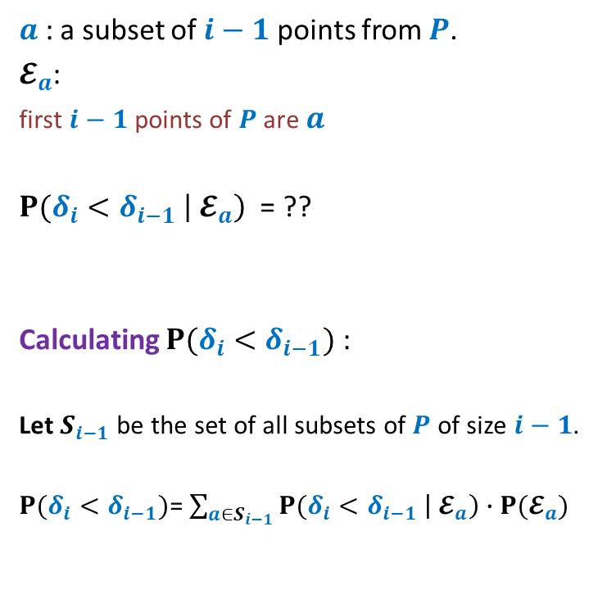
Forward analysis for ${P(δ}_{i}<δ_{i−1})$
$a$ : a subset of $i−1$ points from $P$.
$𝓔_{a}$:
first $i−1$ points of $P$ are $a$
${P(δ}_{i}<δ_{i−1} \left|{ 𝓔}_{a}\right)$ = ??
Calculating ${P(δ}_{i}<δ_{i−1})$ :
Let $S_{i−1}$ be the set of all subsets of $P$ of size $i−1$.
${P(δ}_{i}<δ_{i−1})$= $\sum_{a∈S_{i−1}}{{P(δ}_{i}<δ_{i−1} \left|{ 𝓔}_{a}\right)∙P(𝓔_{a}) }$
$$δ_{i−1}$$
Depends upon $a$
$$δ_{i−1}$$
Grid structure for first $i−1$points

Slide 46
Forward analysis for ${P(δ}_{i}<δ_{i−1})$
An instance of $a$
$$δ_{i−1}$$

Slide 47
Forward analysis for ${P(δ}_{i}<δ_{i−1})$
An instance of $a$
$$δ_{i−1}$$

Slide 48
Backward analysis for $${P(δ}_{i}<δ_{i−1})$$
Closest-pair-algorithm($P$)
Let <$p_{1}$,$p_{2}$,…,$p_{n}$ > be a uniformly random permutation of $P$;
$δ_{2}$← distance($p_{1}$,$p_{2}$);
$G$← Build_Grid($δ_{2}$, ${\{p_{1}, p}_{2}\}$);
For $i=3$ to $n$ do
{ Step 1: locate the cell of the grid $G$ containing $p_{i}$;
Step 2: Compute $δ_{i}$;
Step 3: If $δ_{i}=δ_{i−1}$
Insert($p_{i}$, $G$);
Else
$G$← Build_Grid($δ$, $\{p_{1},…,p_{i}\}$);
}
return $δ_{n}$;

Slide 49

Backward analysis for ${P(δ}_{i}<δ_{i−1})$
$a$ : a subset of $i$ points from $P$.
$𝓔_{a}$: first $i$ points of $P$ are $a$
${P(δ}_{i}<δ_{i−1} \left|{ 𝓔}_{a}\right)$ = ??
Calculating ${P(δ}_{i}<δ_{i−1})$ :
Let $S_{i}$ be the set of all subsets of $P$ of size $i$.
${P(δ}_{i}<δ_{i−1})$= $\sum_{a∈S_{i}}{{P(δ}_{i}<δ_{i−1} \left|{ 𝓔}_{a}\right)∙P(𝓔_{a}) }$
= $\sum_{a∈S_{i} }{\frac{2}{i}∙ P(𝓔_{a}) }$
= $\frac{2}{i}∙$ $\sum_{a∈S_{i} }{P(𝓔_{a}) }$
$$\frac{2}{i}$$
$$δ_{i}$$
$$δ_{i}$$
= $\frac{2}{i}$
Grid structure for first $i$ points

Slide 50
running time of $i$th iteration
$X_{i}$ : running time of $i$th iteration
E[$X_{i}$] = O(1) + $ci$ ∙ ${P(δ}_{i}<δ_{i−1})$
= O(1) + $ci$ ∙ $\frac{2}{i}$
= O(1)
Expected running time of the algorithm :
$$\sum_{i≤n}{\text{E}\text{[}X_{i}\text{]}}$$
$$=\sum_{i≤n}{\text{O}\text{(}\text{1}\text{)}}$$
= $\text{O}\text{(}n\text{)}$

Slide 51
Theorem:
There exists a linear time Las Vegas algorithm
to compute closest pair of points in plane.
Note: We made an assumption
“Distance between each pair of points is distinct.”
Homework:
What will be the time complexity if we discard this assumption ?

